Slide 1
Welcomes You To the Brazos River Recreational Master Plan Workshop

Slide 2
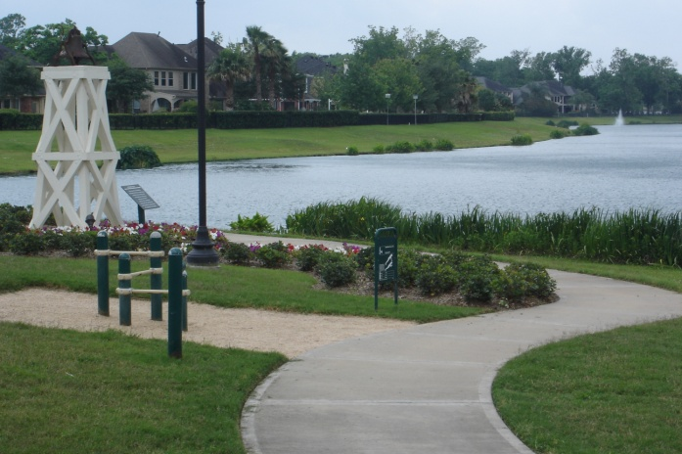
Sienna River Trails
Brazos Bend State Park Staff

Slide 3
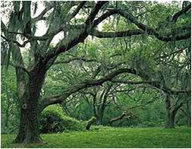
Brazos Bend State Park
Brazos Bend State Park Staff

Slide 4
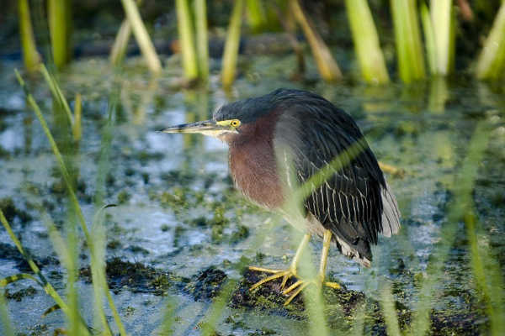
Green Heron
Brazos Bend State Park Staff

Slide 5
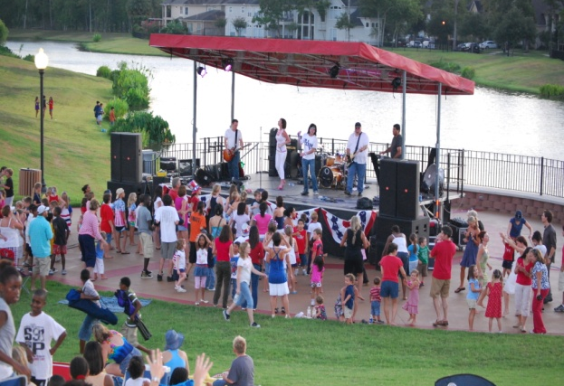
Sienna River Pavilion
Sienna Development

Slide 6
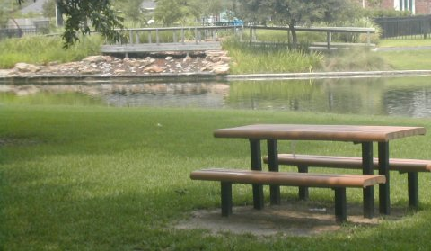
Fort Bend County Park
Brazos Bend State Park Staff

Slide 7
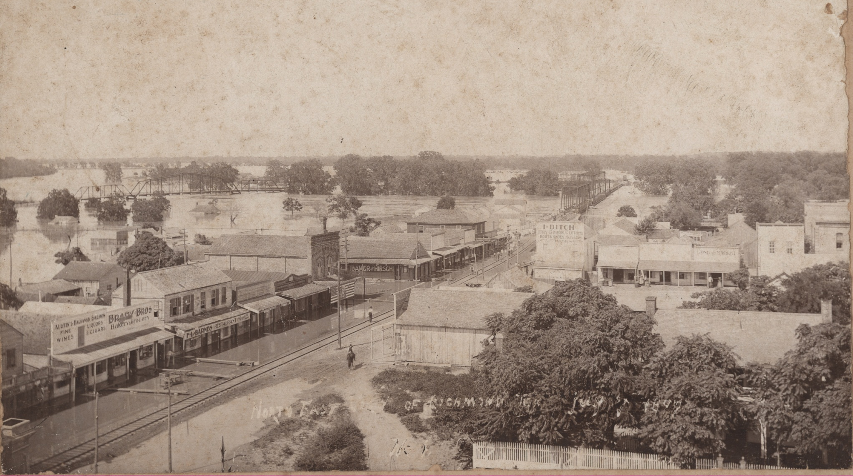
Flooded Richmond , July 1899
Courtesy the Fort Bend County Museum Association Richmond, TX

Slide 8
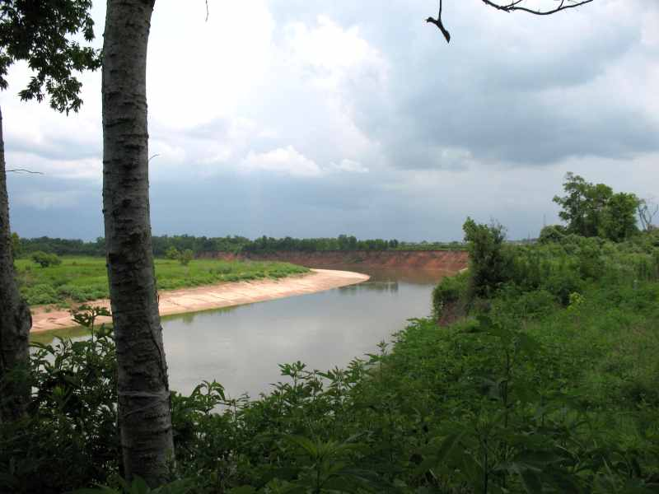
From a High Bank
Dave and Paul Metcalf

Slide 9
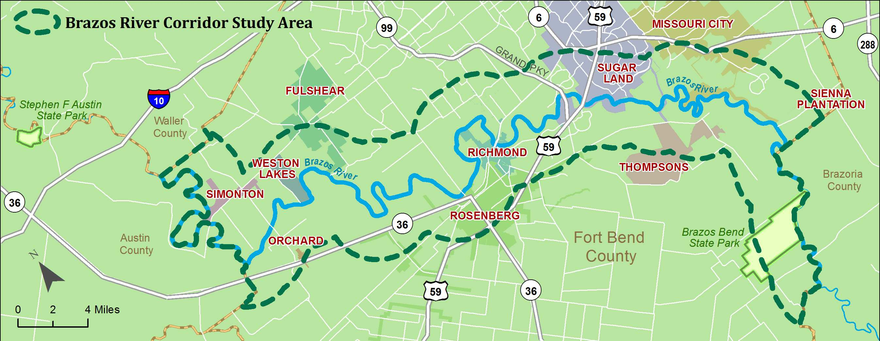
Recreational Master Plan Study Area
Kim Icenhower

Slide 10
Brazos River Citizen
Stock Photo

Slide 11
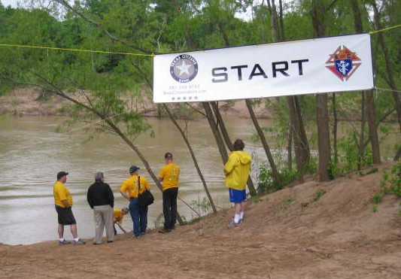
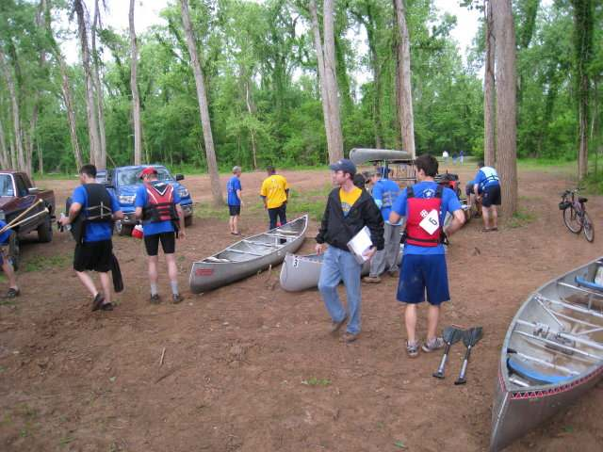
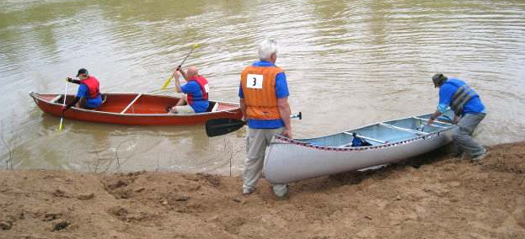
Race on the Brazos
Dave and Paul Metcalf
Dave and Paul Metcalf
Dave and Paul Metcalf
Dave and Paul Metcalf

Slide 12
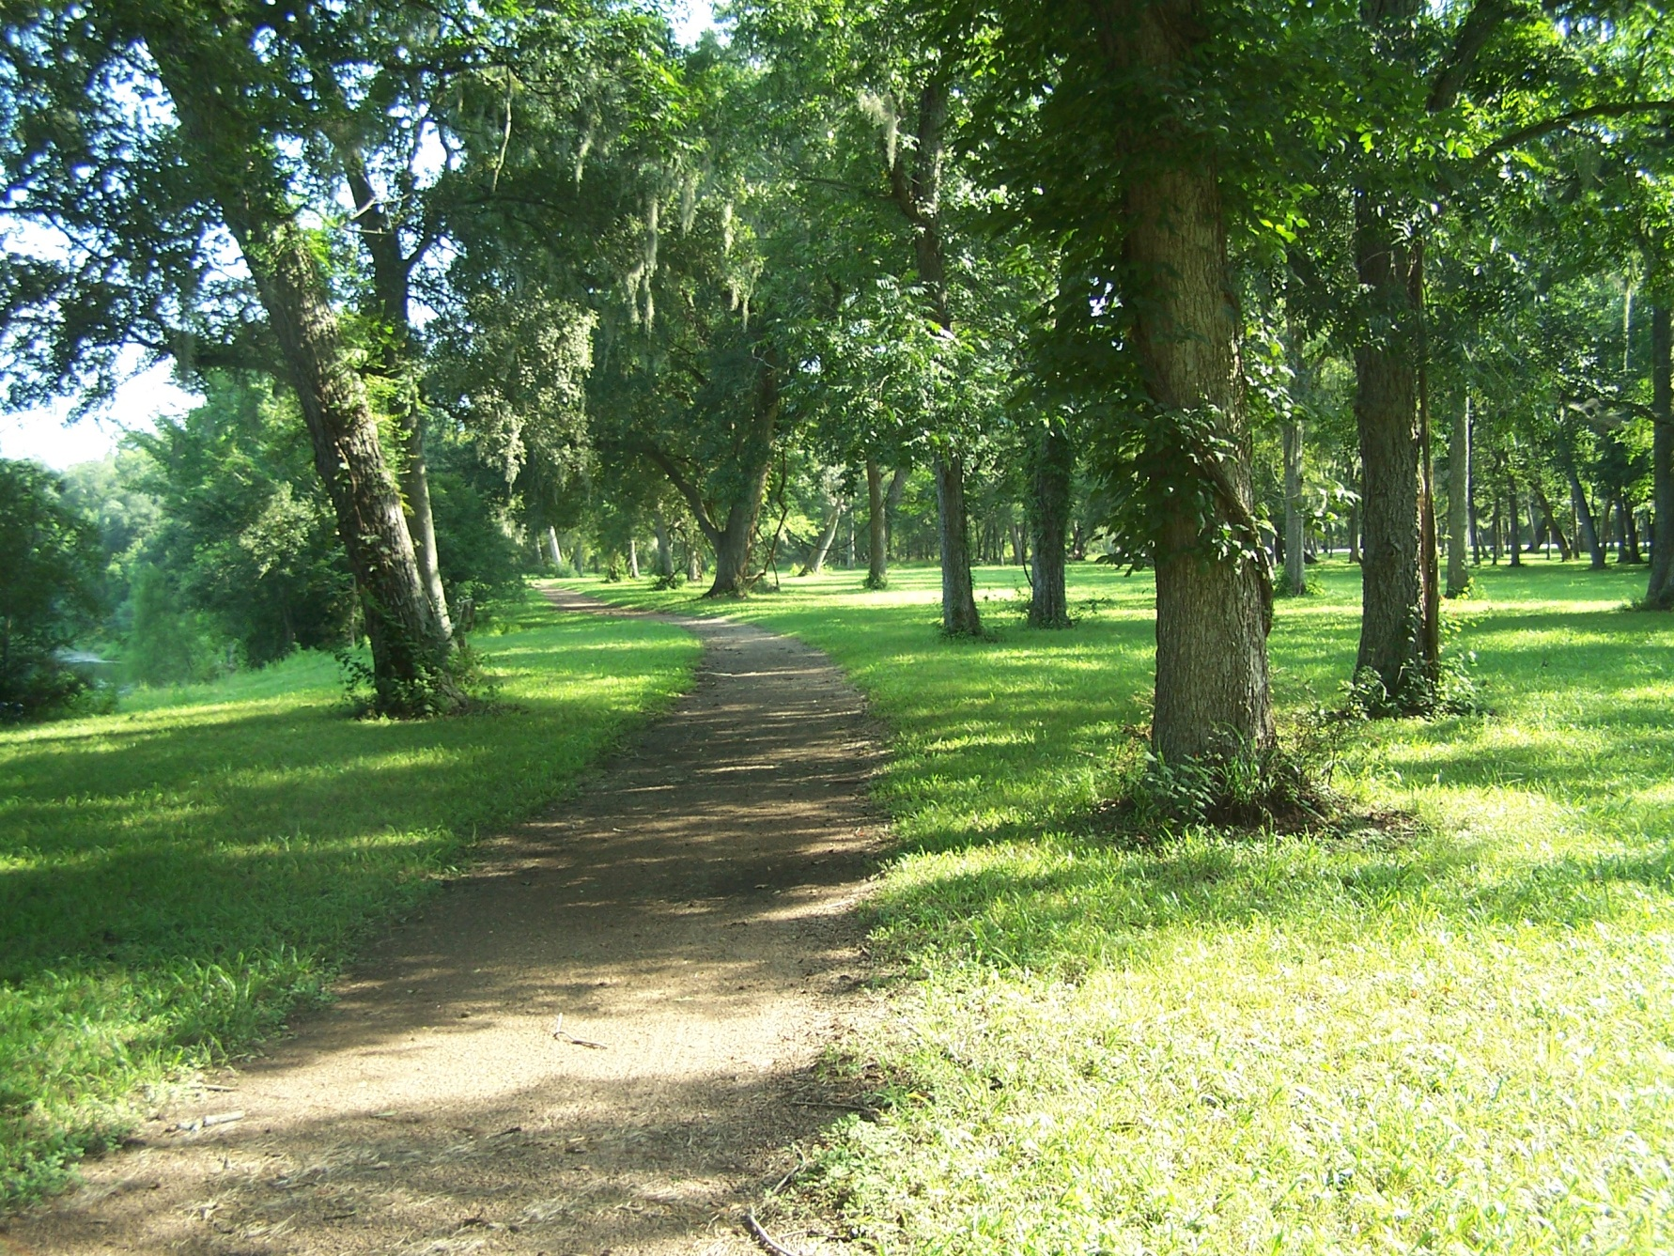
Brazos Bend State Park
Brazos Bend State Park Staff

Slide 13
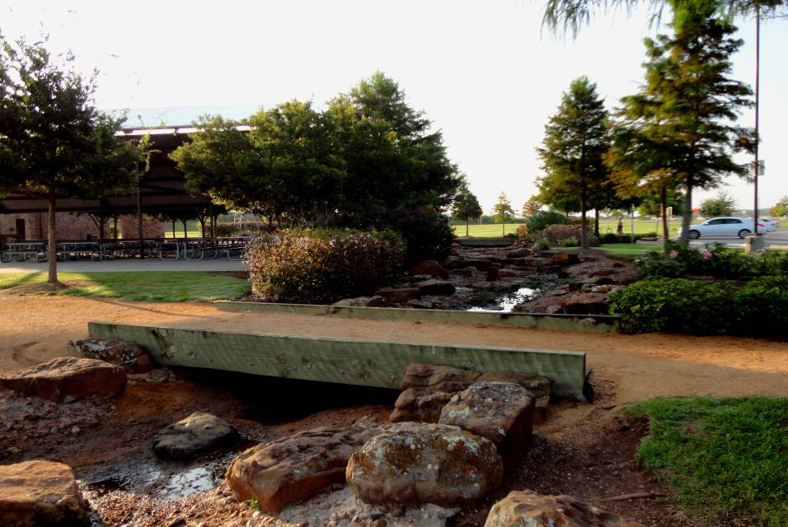
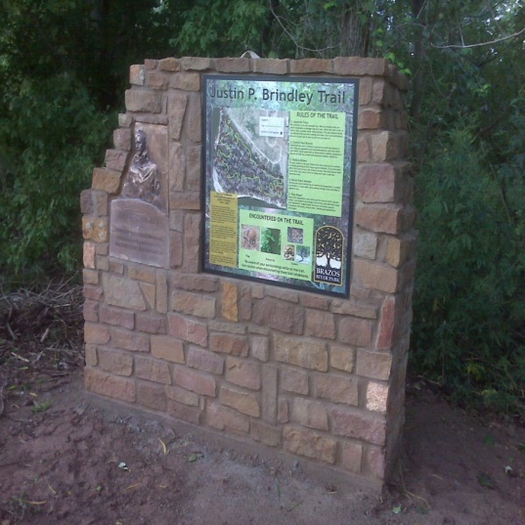
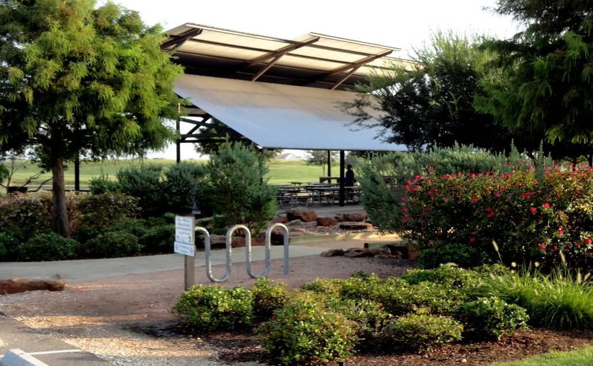
Current Facilities, Sugar Land
Picnic Pavilions
Restrooms
Parking
Trails
Fishing Lake
Playground
Dog park
City of Sugar Land
City of Sugar Land
City of Sugar Land

Slide 14
US Census Bureau

Slide 15
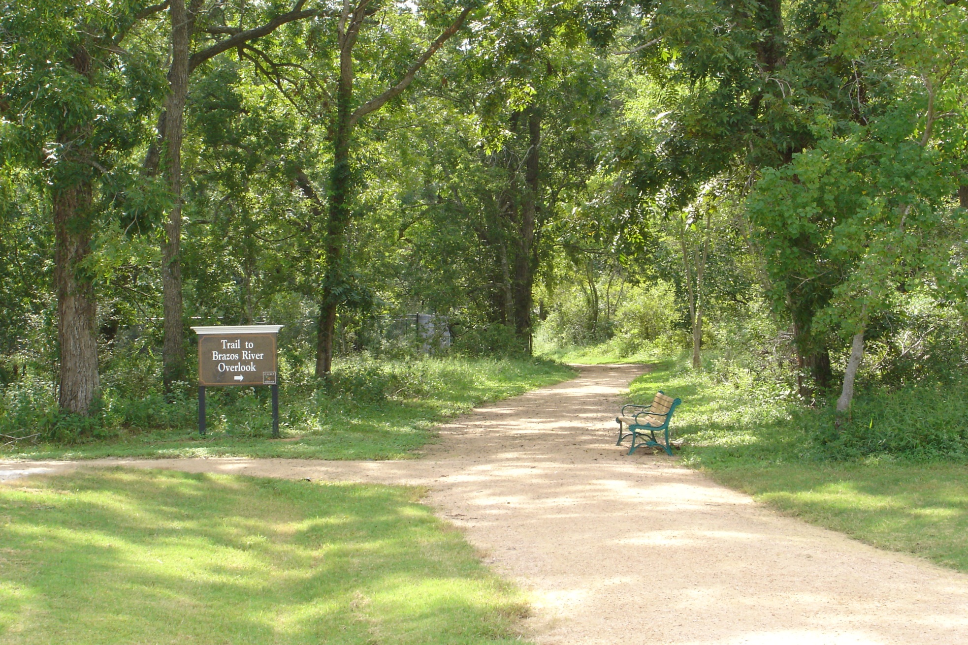
Camp Sienna Trail Head
Sienna Development

Slide 16
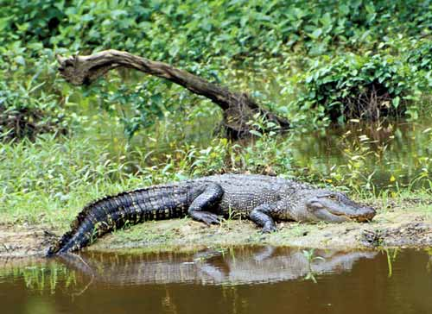
Brazos Bend State Park
Brazos Bend State Park Staff

Slide 17
Welcomes You To the Brazos River Recreational Master Plan Workshop

Slide 18
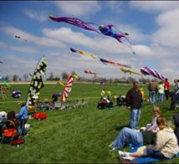
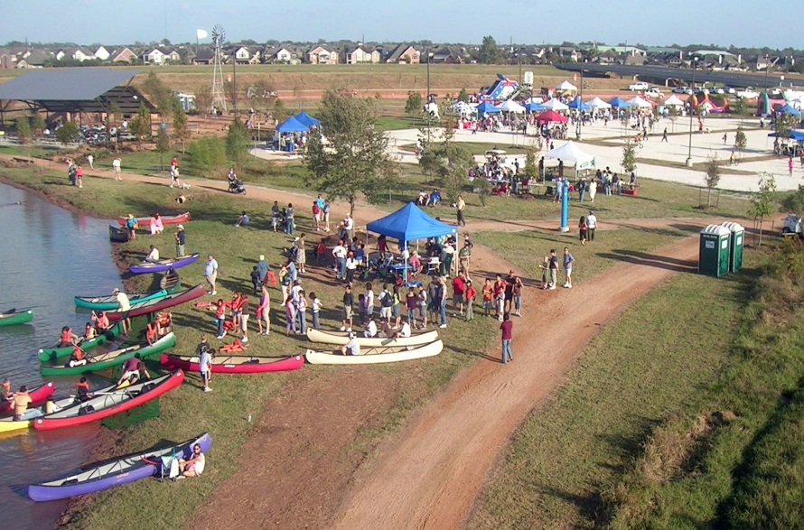
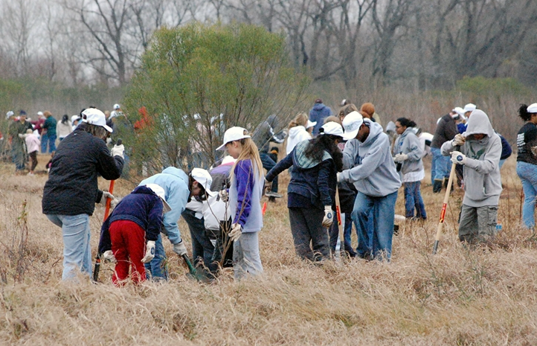
Brazos River Park, Sugar Land
City of Sugar Land
Cultural Kite Festival
Memorial Day
Trees Across Sugar Land
Fun Runs and Walks
Bike Races
City of Sugar Land
City of Sugar Land

Slide 19
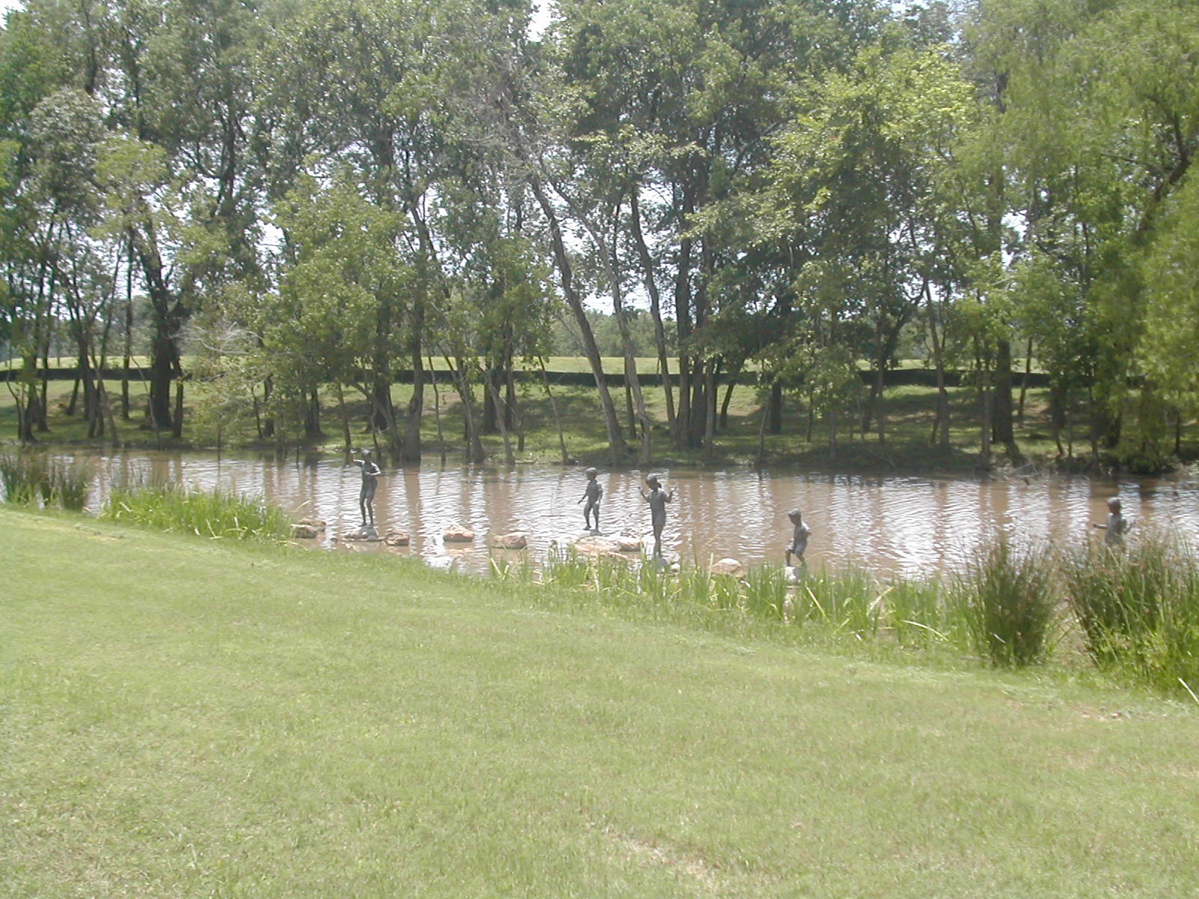
Fort Bend County Park
Brazos Bend State Park Staff

Slide 20
Bald Eagle, Simonton
City of Simonton

Slide 21
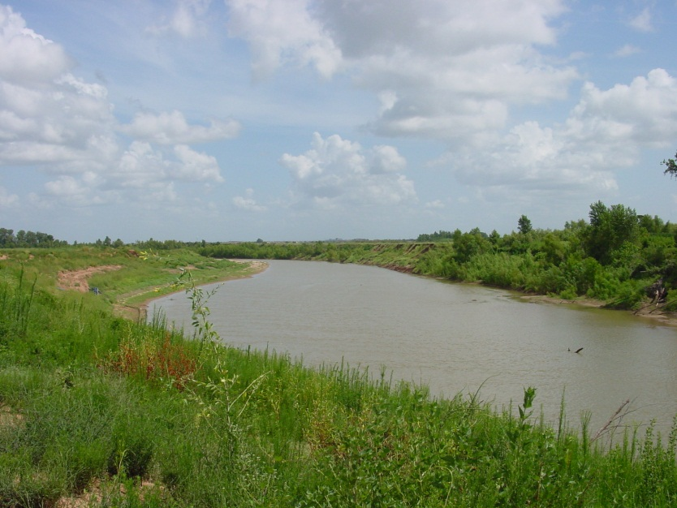
Future Paddle Trail, Sugar Land
City of Sugar Land

Slide 22
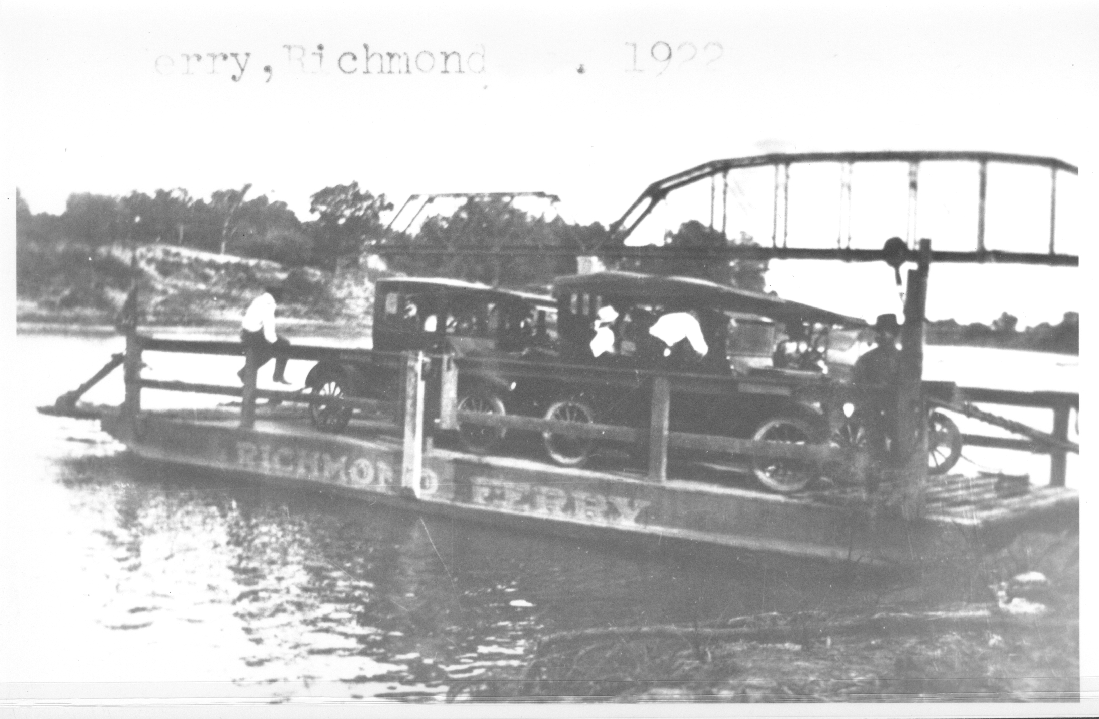
Richmond Ferry, 1922
Stock Photo

Slide 23
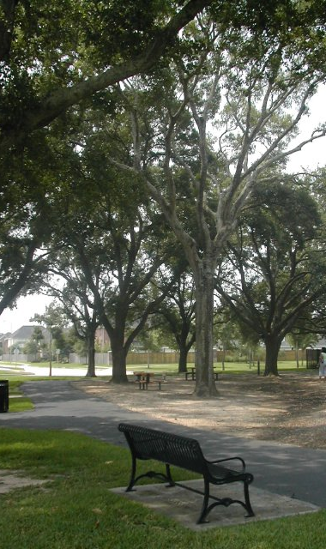
Fort Bend County Park
Brazos Bend State Park Staff

Slide 24
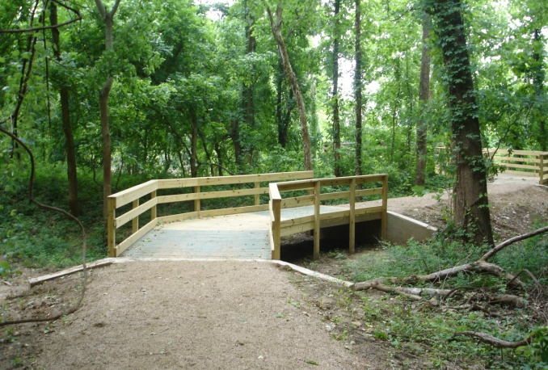
Camp Sienna Trail Boardwalk
Sienna Development

Slide 25
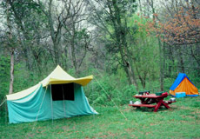
Brazos Bend State Park
Brazos Bend State Park Staff

Slide 26
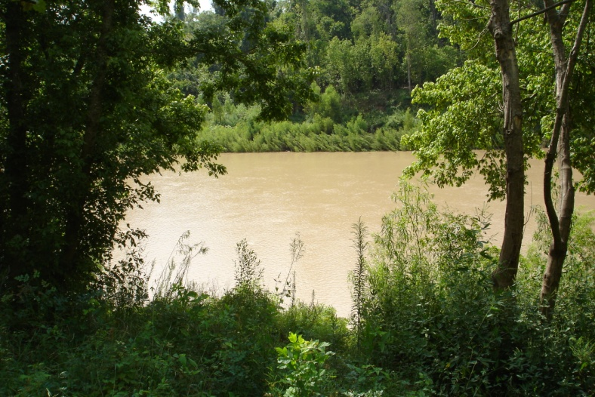
Camp Sienna Trail River View
Sienna Development

Slide 27
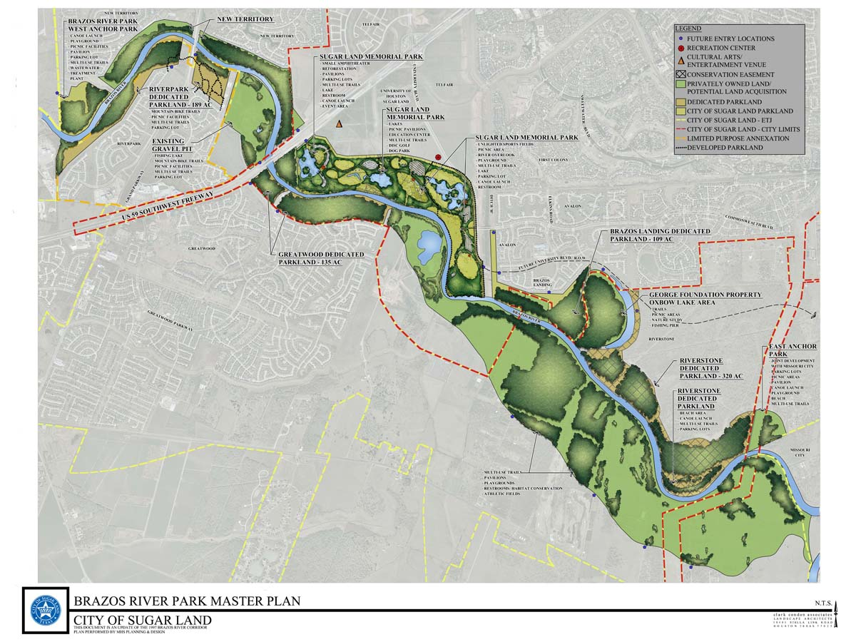
Brazos River Park, Sugar Land
City of Sugar Land
Master Plan

Slide 28
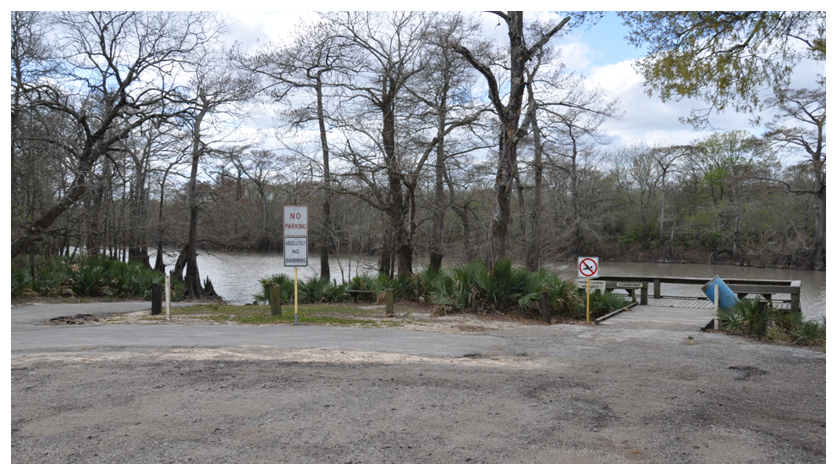
Bates Allen Canoe Launch
Brazos Bend State Park Staff
Brazos Bend State Park Staff

Slide 29
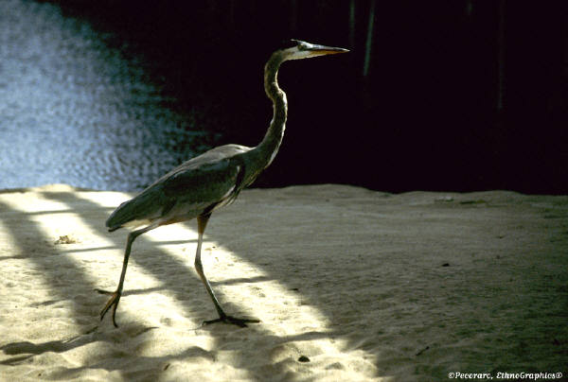
Great Blue Heron on Sandbar
Stock Photo

Slide 30
Brazos Bend State Park
Brazos Bend State Park Staff

Slide 31
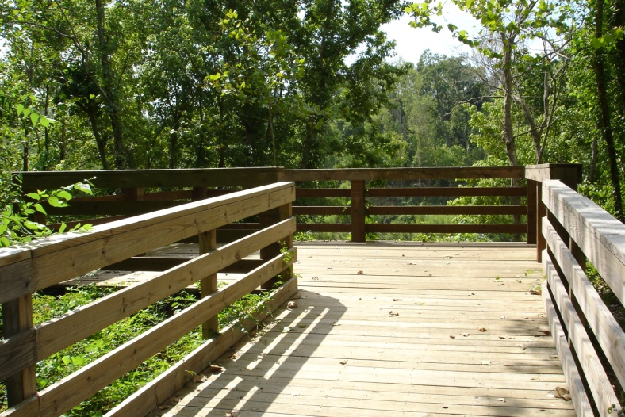
River Overlook at Sienna
Sienna Development

Slide 32
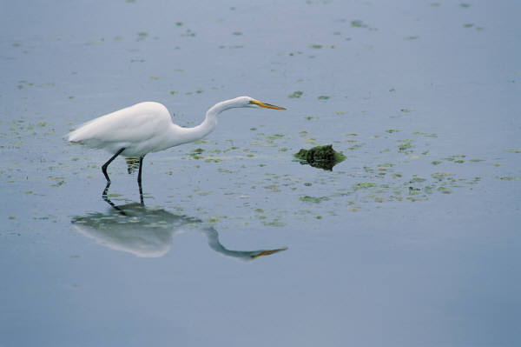
Great Egret

Slide 33
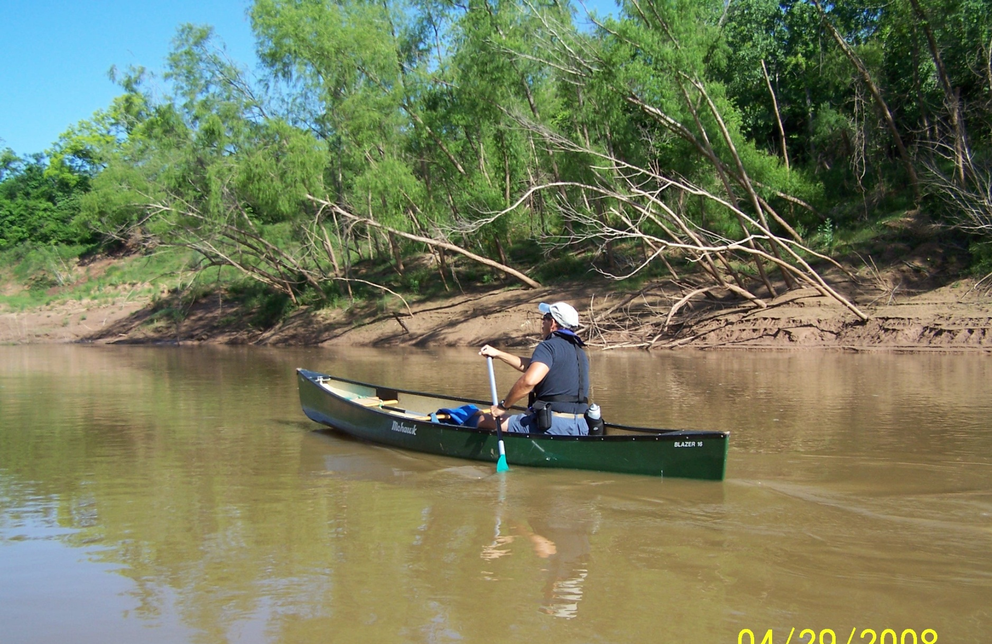
Brazos Bend State Park
Brazos Bend State Park Staff

Slide 34
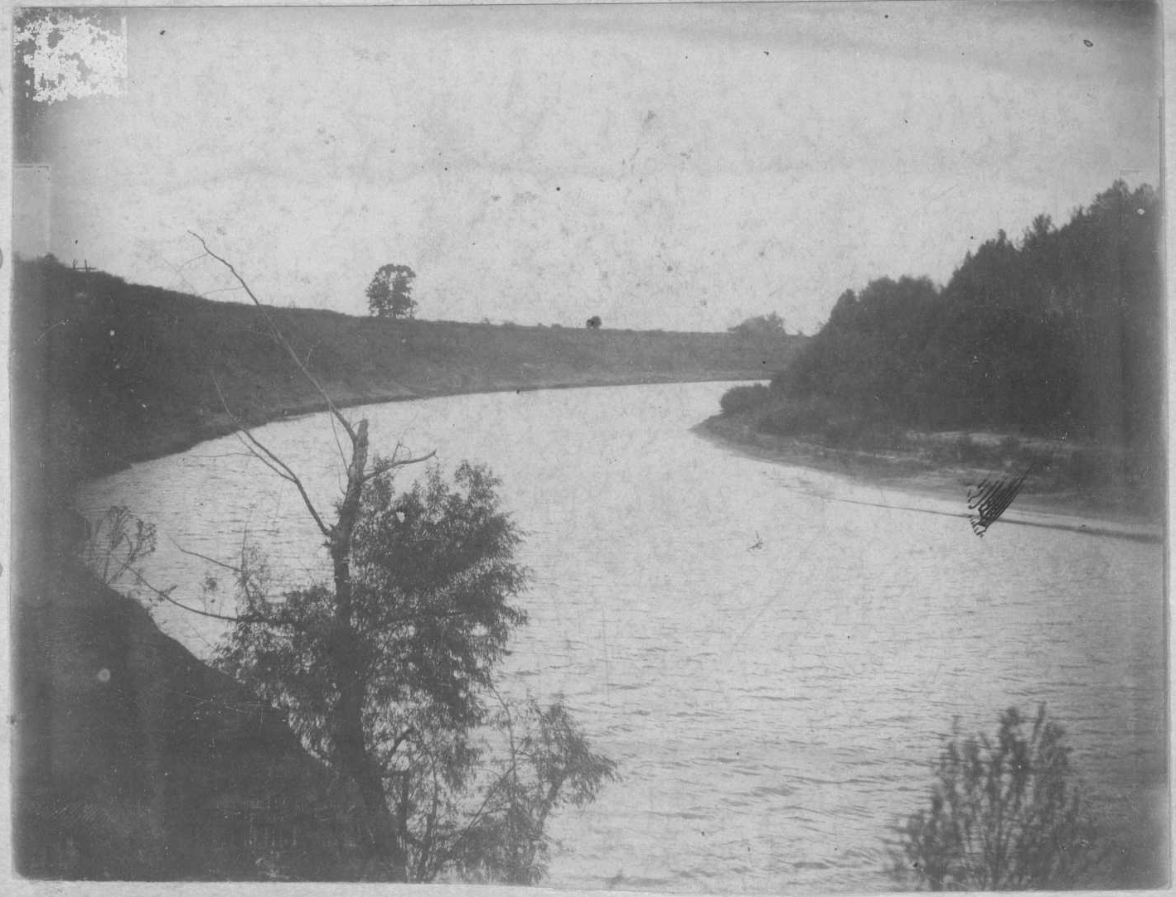
Low Water near Richmond

