Slide 1
Brazos River Recreational Master Plan
2011:
Steering Committee
Vision and Study Area
Plan will be Recommended Projects
Brochure, Map, Facebook Page

Slide 2
Vision
The natural ecosystems of the Brazos River are conserved and appreciated by the community at large.
The relationship of the Fort Bend community to the Brazos River is enhanced by safe public access.
Land trails, paddle trails and parks are connected in a distinguished Brazos River greenway system.

Slide 3
We will do this by:
Assuring that improvements for public use respect wildlife habitat and private lands.
Facilitating public-private partnerships for maximizing shared economic, social and environmental benefits.
Promoting river-oriented facilities and activities that encourage community and regional involvement.

Slide 4
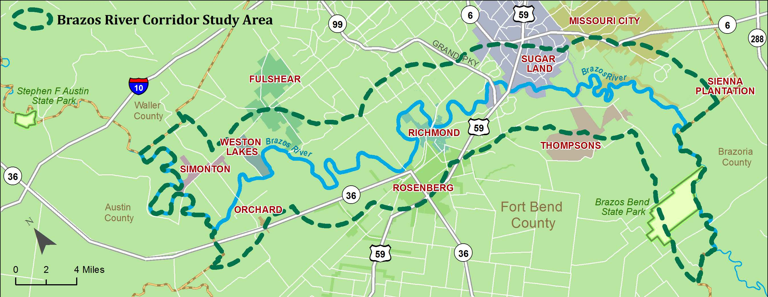
Study Area

Slide 5
Brazos River Recreational Master Plan
2011:
2012:
Now:
Steering Committee
Vision and Study Area
Plan will be Recommended Projects
Brochure, Map, Facebook Page
Collected Information on Facilities and Plans
Conducted Interviews for Issues
Public Survey for Ranking Activities
Workshops for adding projects to list

