Slide 1
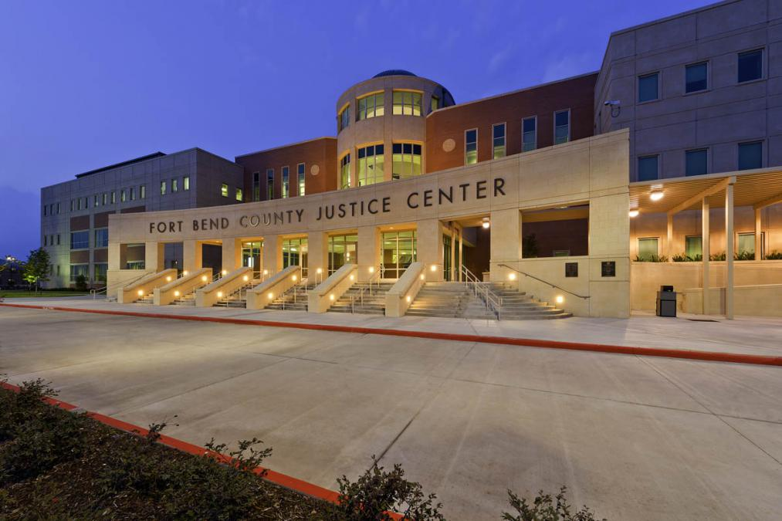
FORT BEND COUNTY COURTS LANGUAGE ACCESS COMMUNITY MEETING 2021

Slide 2
Language Access Director (LAD)
Cecilia Lopez-Flores is the Courts’ LAD. She is a Master Licensed Interpreter as defined under Texas Government Code §157.101(d)(2) which means that she is a court state-certified Spanish professional interpreter.
Cecilia has been serving our courts for almost four years now providing quality interpretation and translation, as well as coordinating language access services.

Slide 3
Introduction to the Fort Bend County Courts Language Access Plan
The Fort Bend County Courts at Law and District Courts are required by federal law to provide meaningful access to all limited English proficient(LEP) individuals.
An LEP individual is a someone who does not speak English as their primary language and who has a limited ability to read, speak, write, or understand the English language.

Slide 4
Language Assistance means providing interpretation (oral language) services or translation (written language) services to individuals who have limited English proficiency or LEP.
Our mission is to place LEP persons on an equal footing with those who understand English by providing quality language professionals and to reaffirm our commitment to meaningful access to justice for all.

Slide 5
Fort Bend County (FBC) will “institute a language access program that will provide language assistance services at no cost to LEP individuals in all civil and criminal cases in FBC Courts and to implement policies and procedures that are compliant with Title VI” of the Civil Rights Act of 1964 and its regulations.
June 28, 2021 Memorandum of Agreement with U.S. Department of Justice, II.B., https://go.usa.gov/xecnF.

Slide 6
What are the roles and responsibilities of the LAD?
The LAD provides:
Language Interpretation Services in Spanish during court proceedings and translation of written documents
Schedules master licensed interpreters (where applicable) to provide Language Interpretation Services for the Courts in languages other than Spanish; and
Assists in developing policies, forms, and procedures to administer the LAP.

Slide 7
Roles of LAD and Court Coordinator
LEP individuals may contact the LAD or the Courts’ Coordinator via the phone, in Court, by e-mail, or other means.
The Courts have designated each Court Coordinator as the primary point of contact for all LEP services.

Slide 8
What non-English languages are spoken in Fort Bend County?
Spanish
Vietnamese
Chinese
Urdu
Malayalam
Tagalog
Gujarati
Hindi
Arabic
According to the 2010 census data, nine (9) languages other than English spoken at home by at least one thousand (1,000) Fort Bend County LEP residents.

Slide 9
In addition to these 9 languages, many other languages are spoken in Fort Bend County.
The Court will provide “meaningful access” to all LEP persons who speak a language other than English.

Slide 10
When Must Language Access Services Be Provided?
Language Access Services must be provided for both Criminal and Civil cases and in all court operations.

Slide 11
For Criminal Cases…
Available information regarding LEP arrestees will be provided to the Judge or Magistrate hearing the case, who will make note of the language spoken in the case file.

Slide 12
When filing a civil matter…
Plaintiff(s) shall disclose whether they reasonably anticipate that a party or witnesses will require Language Interpretation Services and the language(s) spoken.
All other parties to a suit shall disclose whether they reasonably anticipate that a party or witness will require Language Interpretation Services at the time of appearance in the case.

Slide 13
Court Operations
Court Operations are services and programs, other than courtroom proceedings, that are specifically required or ordered by the Court.

Slide 14
What resources are available to help identify and assist LEP individuals?
Bilingual Staff
I Speak Cards
Language Access Website
fbctx.gov/languageaccess
Signage throughout the courthouse

Slide 15
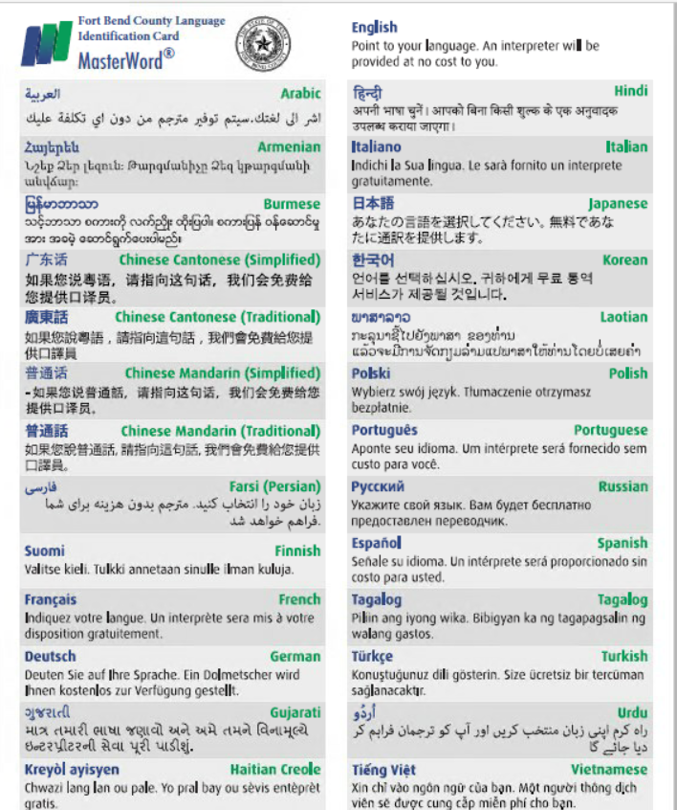
“I speak” cards

Slide 16
“I speak” cards
“I speak” cards are located in each Courtroom, at the information desk, and at the bailiff’s station at the entrance to the Justice Center.

Slide 17
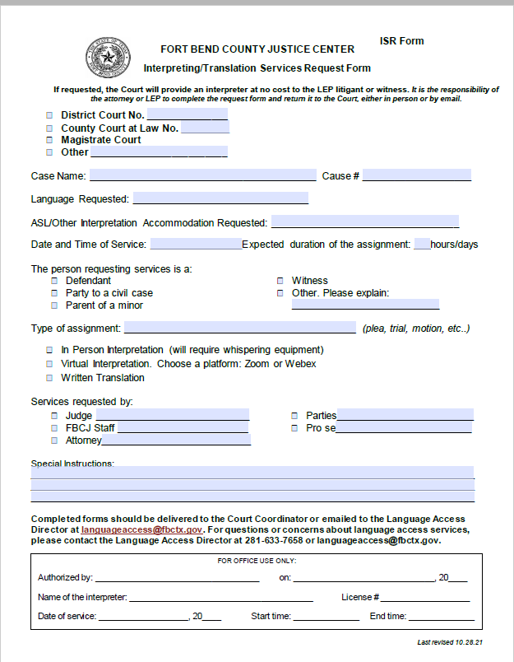
Interpreting Services Request Form

Slide 18
These forms are available in: If the person who needs assistance speaks a language other than the 9 identified languages, staff can contact an over-the-phone interpreter for assistance in filling out the form.
Interpreting Services Request Form
Spanish Vietnamese Chinese Urdu Malayalam | Tagalog Gujarati Hindi Arabic

Slide 19
Completed forms must be submitted to the Court Coordinator or the Language Access Director at least 72 hours before any appearance, hearing, or trial at which counsel reasonably anticipates the need for language interpretation in one of the nine identified languages:
Interpreting Services Request Form
Spanish Vietnamese Chinese Urdu Malayalam | Tagalog Gujarati Hindi Arabic

Slide 20
Counsel or a pro se individual should give fourteen (14) days notice for the need of Language Interpretation Services in any other language. Matter(s) may be adjourned/reset at the Court’s discretion and in the interest of justice when licensed/qualified interpreters cannot be timely located, in accordance with applicable law.
Interpreting Services Request Form

Slide 21
Interpreting Services Request Form
Pro se LEP Individuals shall be informed of the requirement to complete a request for Language Interpretation Services in their native language by use of a Language Line or other means.
Absent such notice or request, the Court will exercise its discretion and act in the interest of justice and pursuant to applicable law.

Slide 22
Not everyone can serve as a court interpreter.
Only an individual licensed under Chapter 157 of the Texas Government Code to interpret court proceedings for an individual who can hear but who has no or limited English proficiency, or an individual who is substituted for such a licensed interpreter in accordance with law who has received training in the skills of interpretation, can competently render a message spoken from one language into one or more other languages.

Slide 23
Master Interpreters or MI’s
The LAD shall provide a Master Interpreter or MI in the language spoken by the LEP individual in accordance with Texas law.
If there is a MI for the language needed within 75 miles of the Justice Center, but the MI is unavailable at the time needed for Language Interpretation Services, then the Court may adjourn/reset the proceedings until a MI is available.

Slide 24
….then the LAD shall use her best efforts to locate an Interpreter who is competent to provide Language Interpretation Services to the LEP individual either in person, via VRI (video remote interpreting), or through a Language Line. The Court shall make reasonable inquiry to assure that such Interpreter is competent to provide Language Interpretation Services.

Slide 25
Please remember that
the interpreter may not be a party or an attorney for a party to the proceeding.

Slide 26
Can an LEP person provide their own interpreter?
A party in a case or a witness may provide his or her own interpreter at his or her own cost; however,
they must first be made aware that an Interpreter will be made available at no cost to the litigant or witness;
then the Court shall make a reasonable inquiry to assure that the interpreter chosen by counsel is competent/qualified/licensed to provide Language Interpretation Services in compliance with both Federal and Texas law.

Slide 27
It is inappropriate for Court staff to request that an LEP person provide their own interpreter or use a family member or an attorney to act as an Interpreter.

Slide 28
Written Language Services
Written documents must also be translated into
Spanish Vietnamese Chinese Urdu Malayalam Tagalog Gujarati Hindi Arabic

Slide 29
Complaint Process
Any individual who wants to report that:
requested interpreter services are not being provided; or
a language barrier (such as poor quality interpreting) exists
may complete a Language Access Complaint Form.

Slide 30
Complaint Process
Complaint forms can be found:
at the entrance to the Justice Center,
the information desk on the first floor,
in each courtroom,
or by request from the Language Access Director.

Slide 31
Evaluation and Update of LAP
The LAD will routinely review the LAP for any required modifications resulting from changes to federal or state laws, demographic shifts, or operating procedures.
We welcome your comments and suggestions!
Your input will help make Language Access Services available for all.

Slide 32
Contact Information
When in doubt, contact the Language Access Director or your Court Coordinator for assistance.
Language Access Director
Cecilia Lopez-Flores
languageaccess@fbctx.gov
Ph (281) 633-7658
Cell (281) 383-8304

